Slide 1
If bricklayer-lite
Is still blocked

Slide 2
Continue your Objects Around Bryan in The Grid
Save and upload to TEAMS

Slide 3
www.codecademy.com
Sign up (or log in if you already have an account)
If you have little to no previous coding experience select one of the following:
“Make a Website”
“Introduction to JavaScript”
If you have some previous coding experience select one of the above or from the following:
“Learn Python”
“Learn Java”
“Learn Rails”

Slide 4
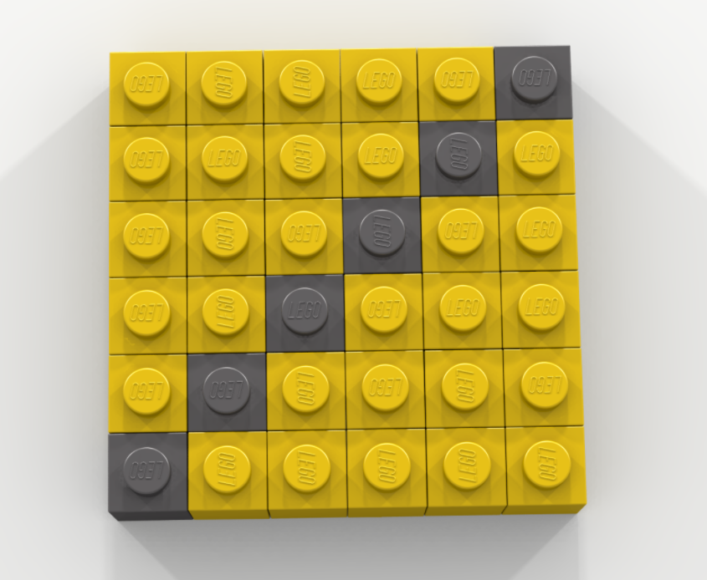
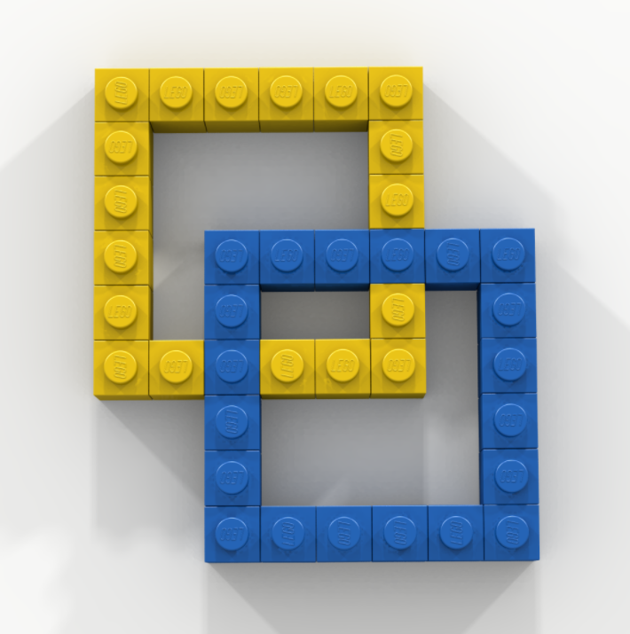
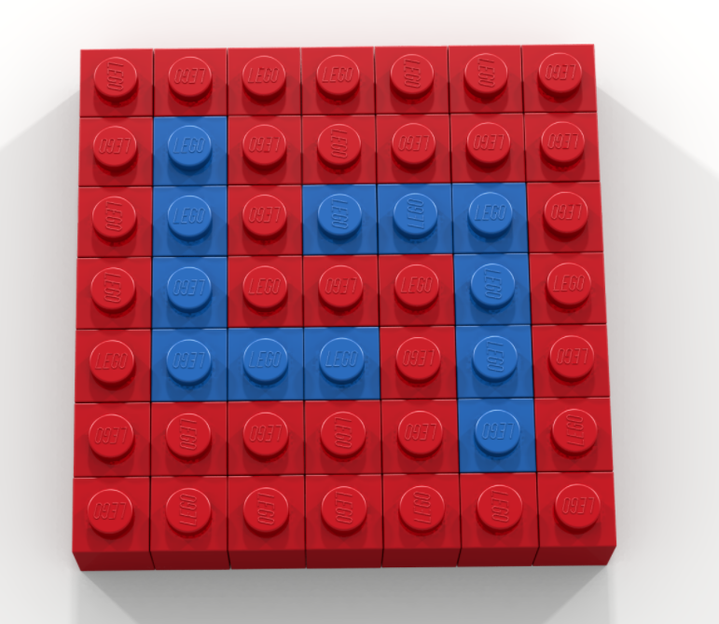
Bell Work: Create the Following 3 Objects in the same Bricklayer-Lite Grid

Slide 5
Math analysis
Day 10

Slide 6
Objective
Finish the image from last class.
Use Bricklayer-Lite to code objects from around the building
Practice our naming conventions

Slide 7
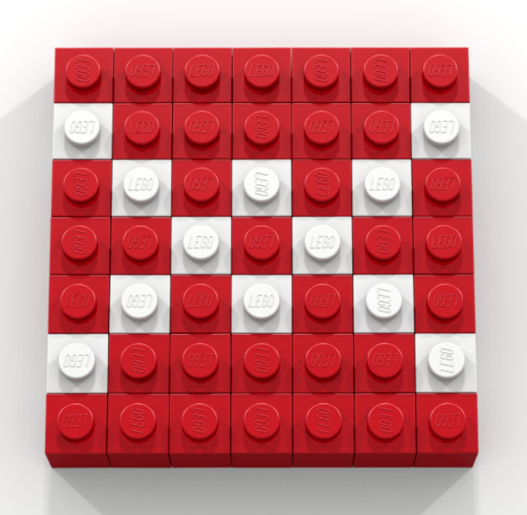
From last time…

Slide 8
Bricklayer-Lite
Using Bricklayer-Lite code, recreate the following objects
Save your code, and upload them into the appropriate folder:
5_Objects Around Bryan In Bricklayer-Lite

Slide 9
How to name our files for saving
Name_object-coded.xml
For example:
Cuddy_yellow-square-gray-diagonal.xml

Slide 10
Combining The Grid and Bricklayer-Lite
Log into Teams, navigate to 5_Objects Around Bryan in The Grid folder, and download your files from last time
Open The Grid from bricklayer.org and pull up your first file
In a new tab, open up Bricklayer-Lite
Begin coding your Grid in Bricklayer-Lite

Slide 11
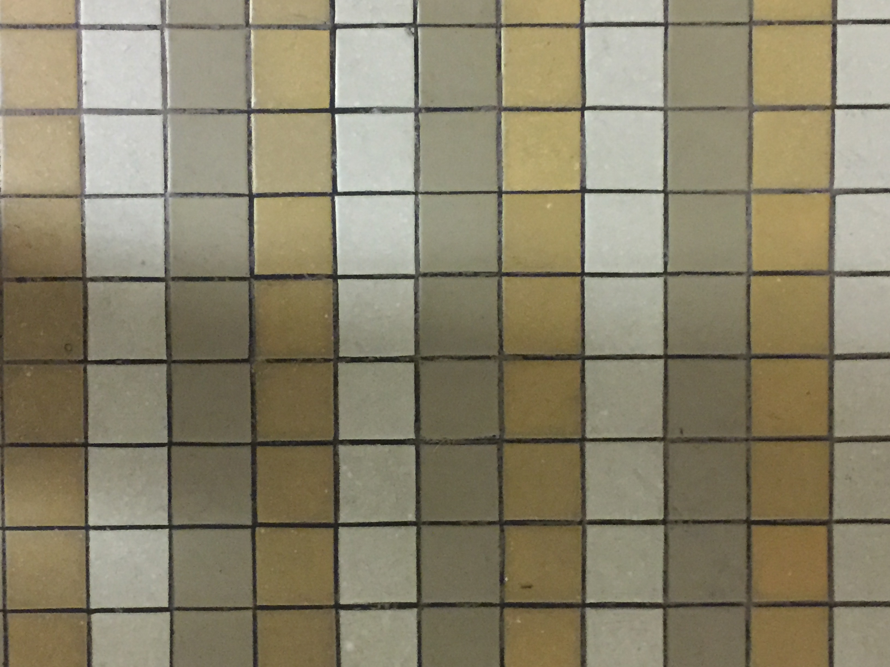
Where have you seen this pattern? Code it in Bricklayer-Lite.

Slide 12
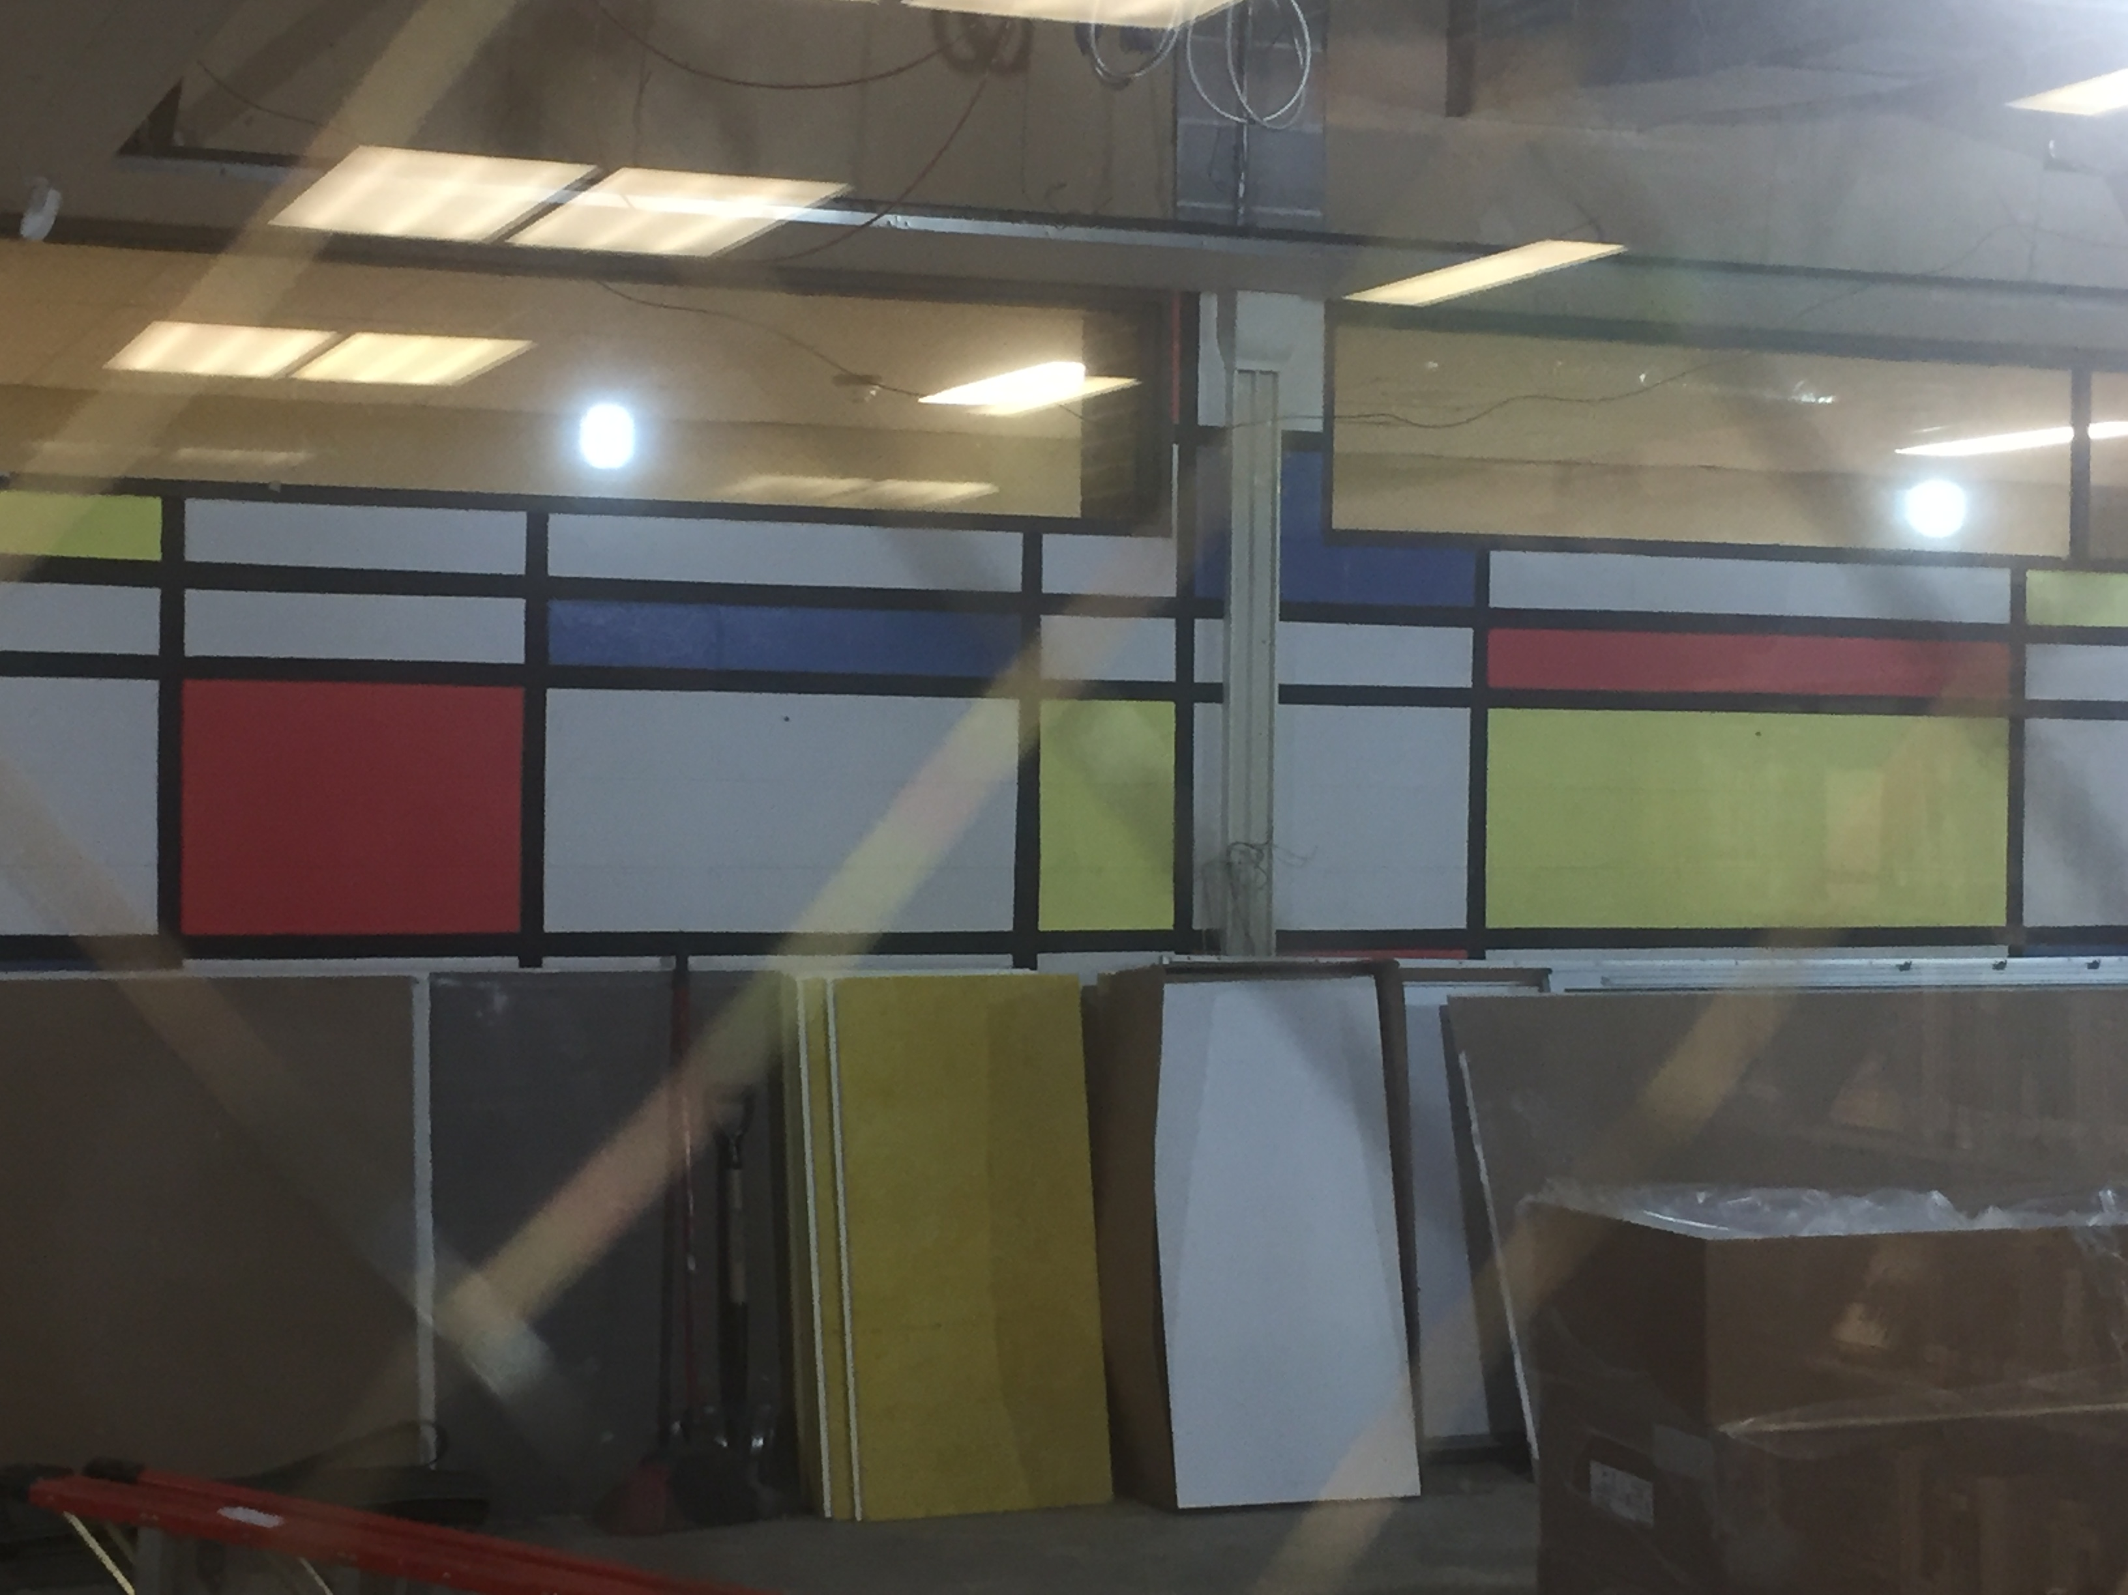
Where have you seen this pattern? Code it in Bricklayer-Lite.

Slide 13
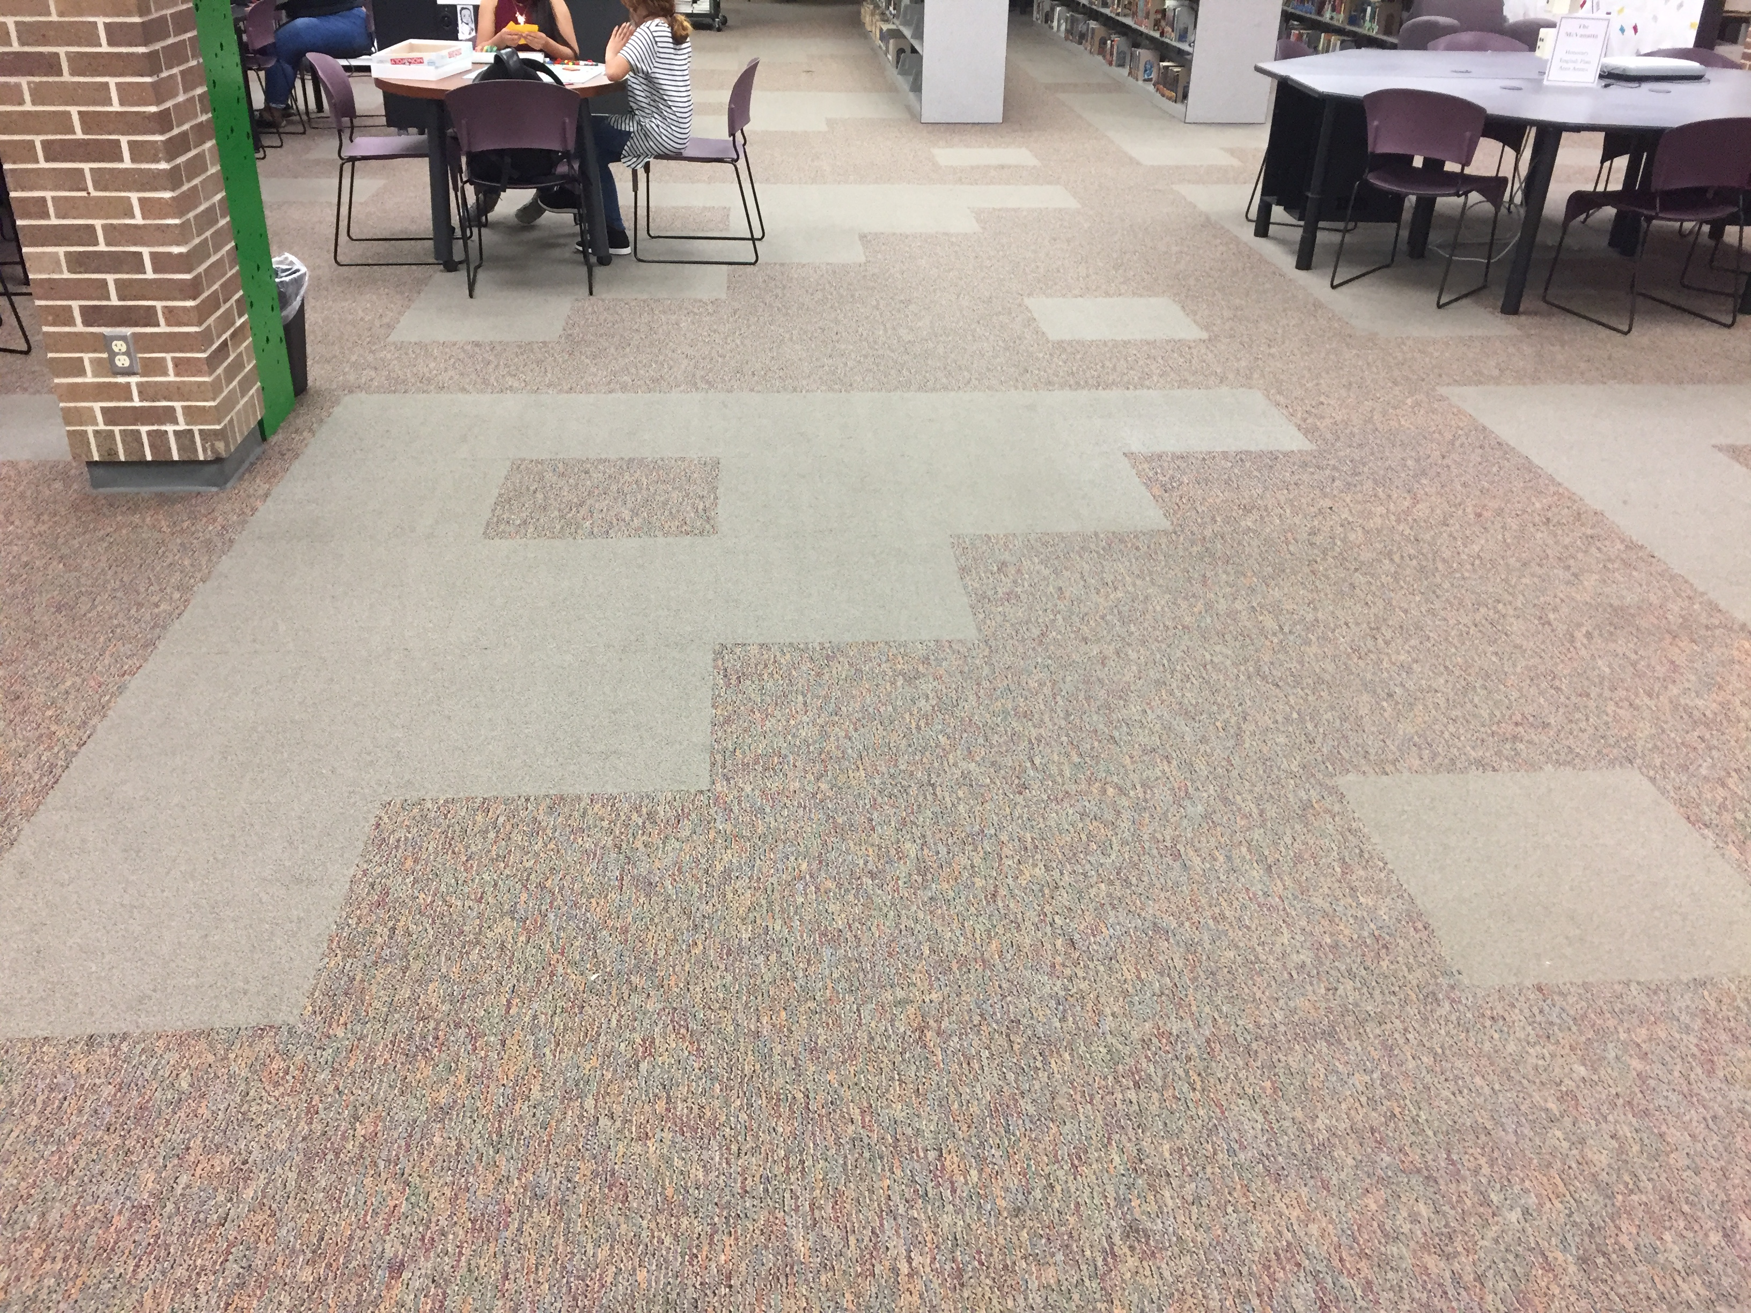
Where have you seen this pattern? Code it in Bricklayer-Lite.

Slide 14
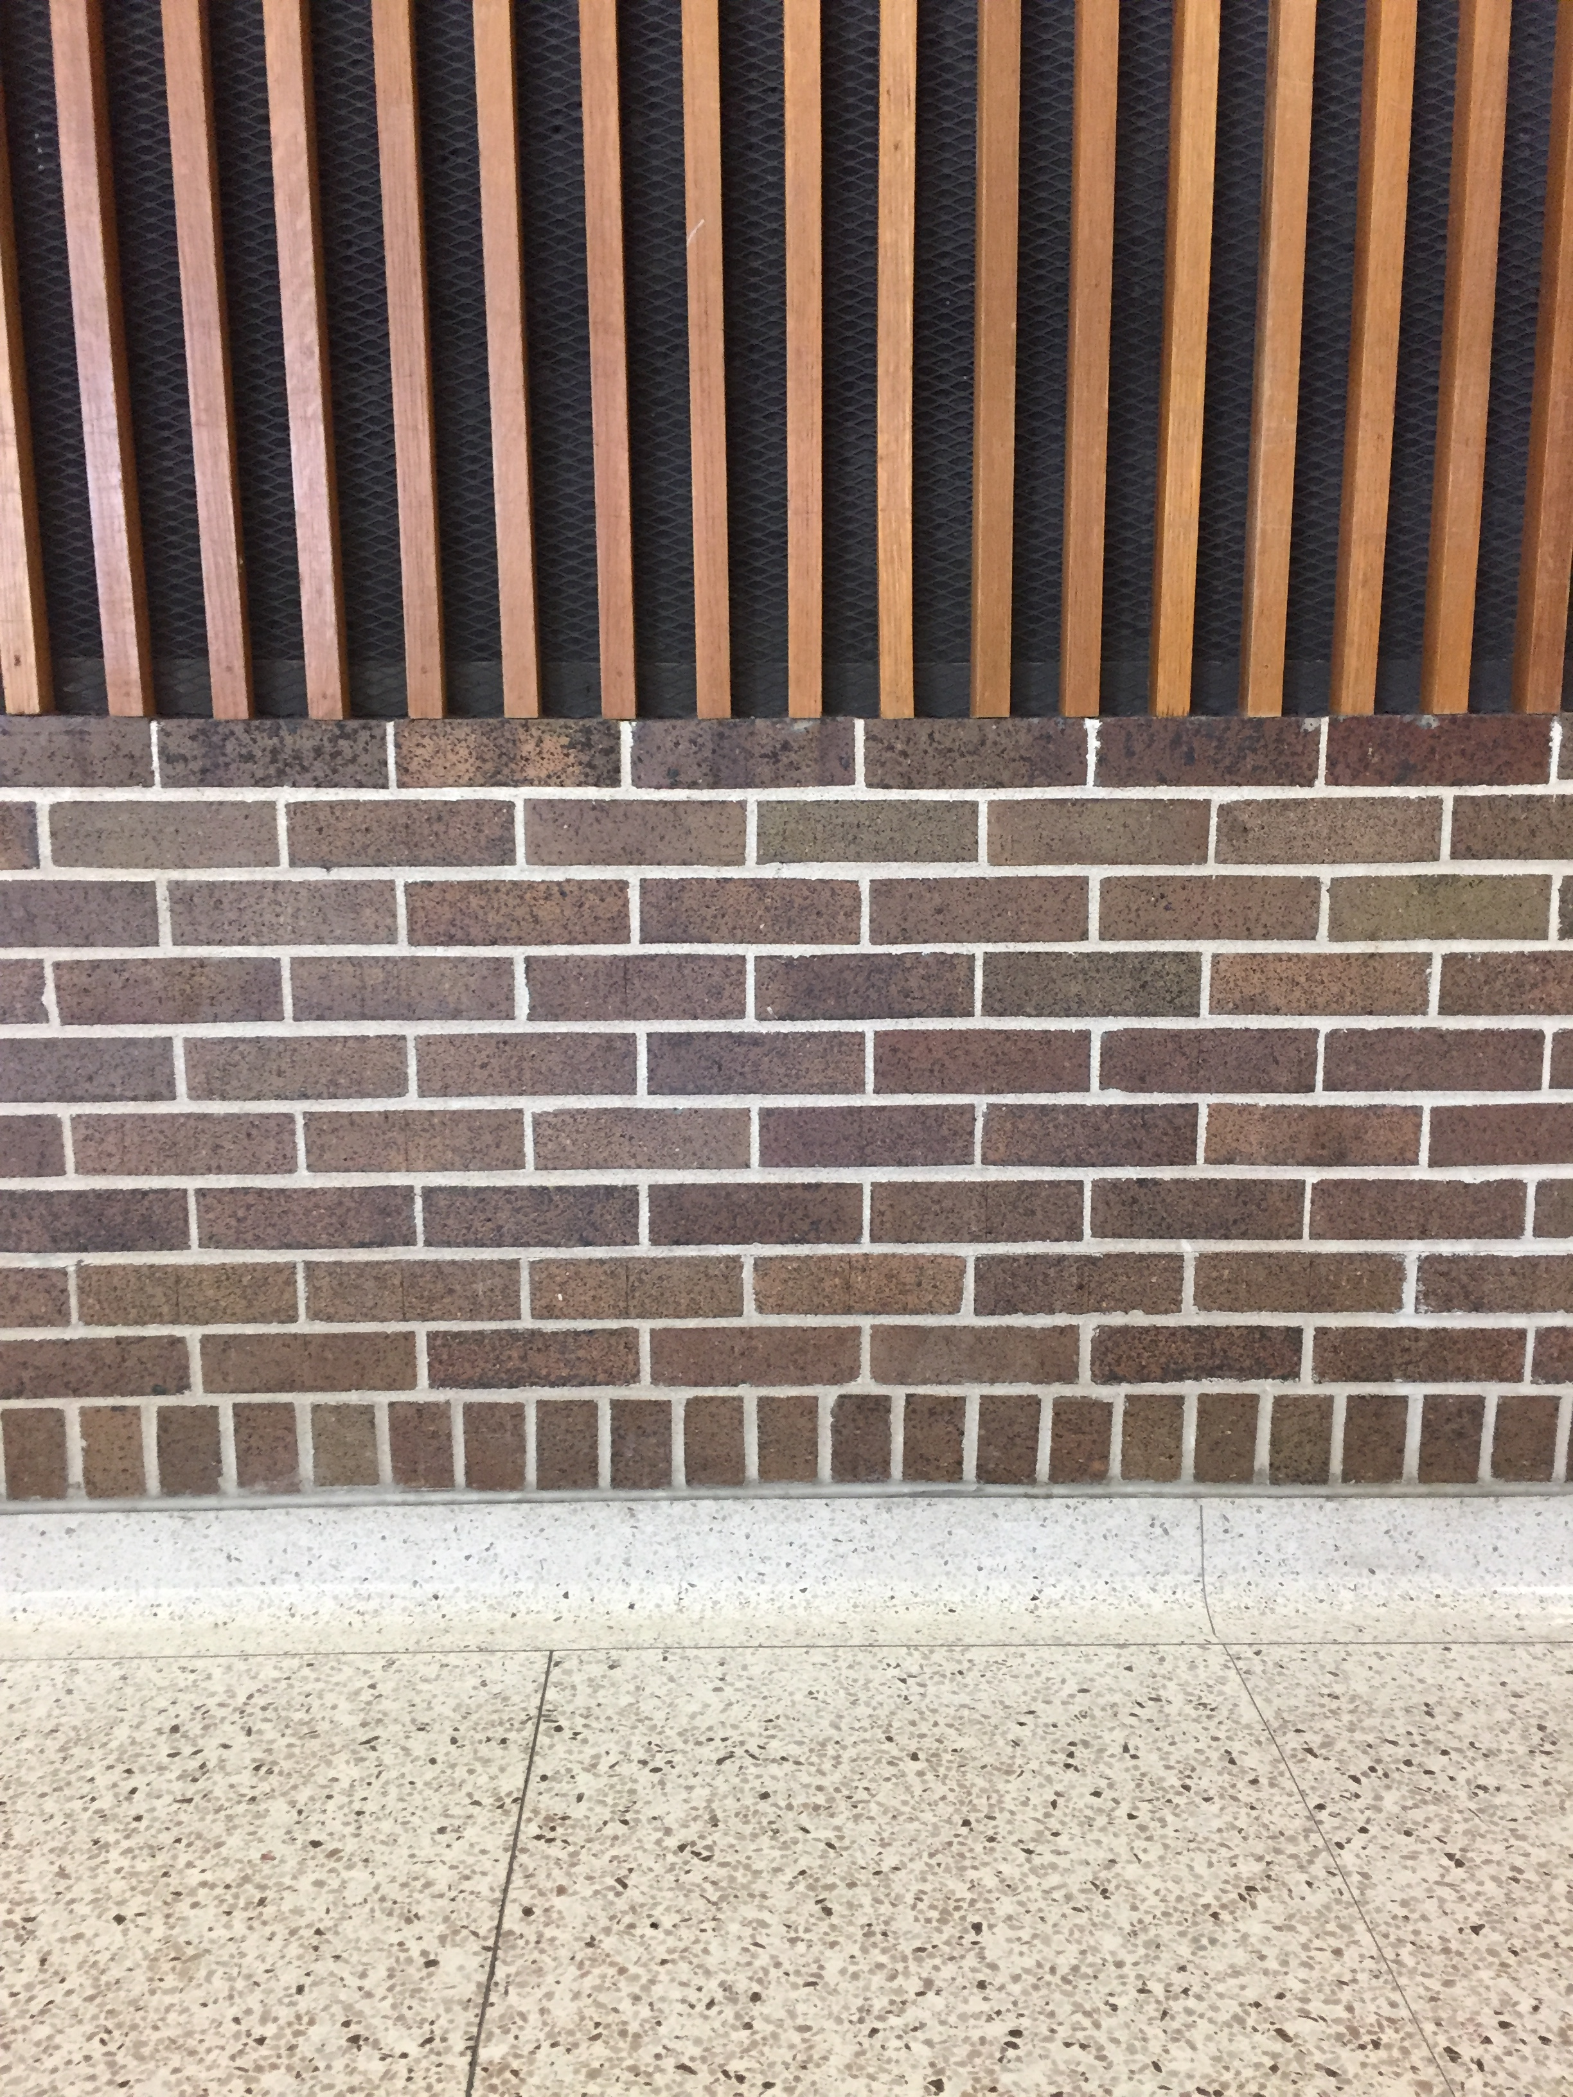
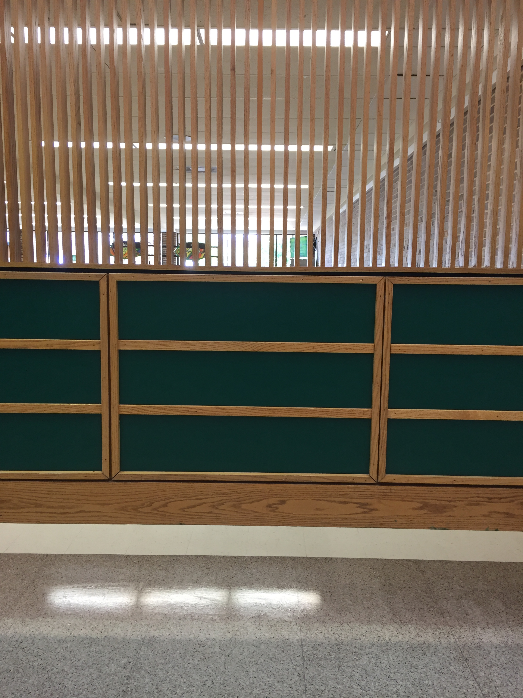
Where have you seen this pattern? (just pick 1 to code in Bricklayer-Lite)

Slide 15
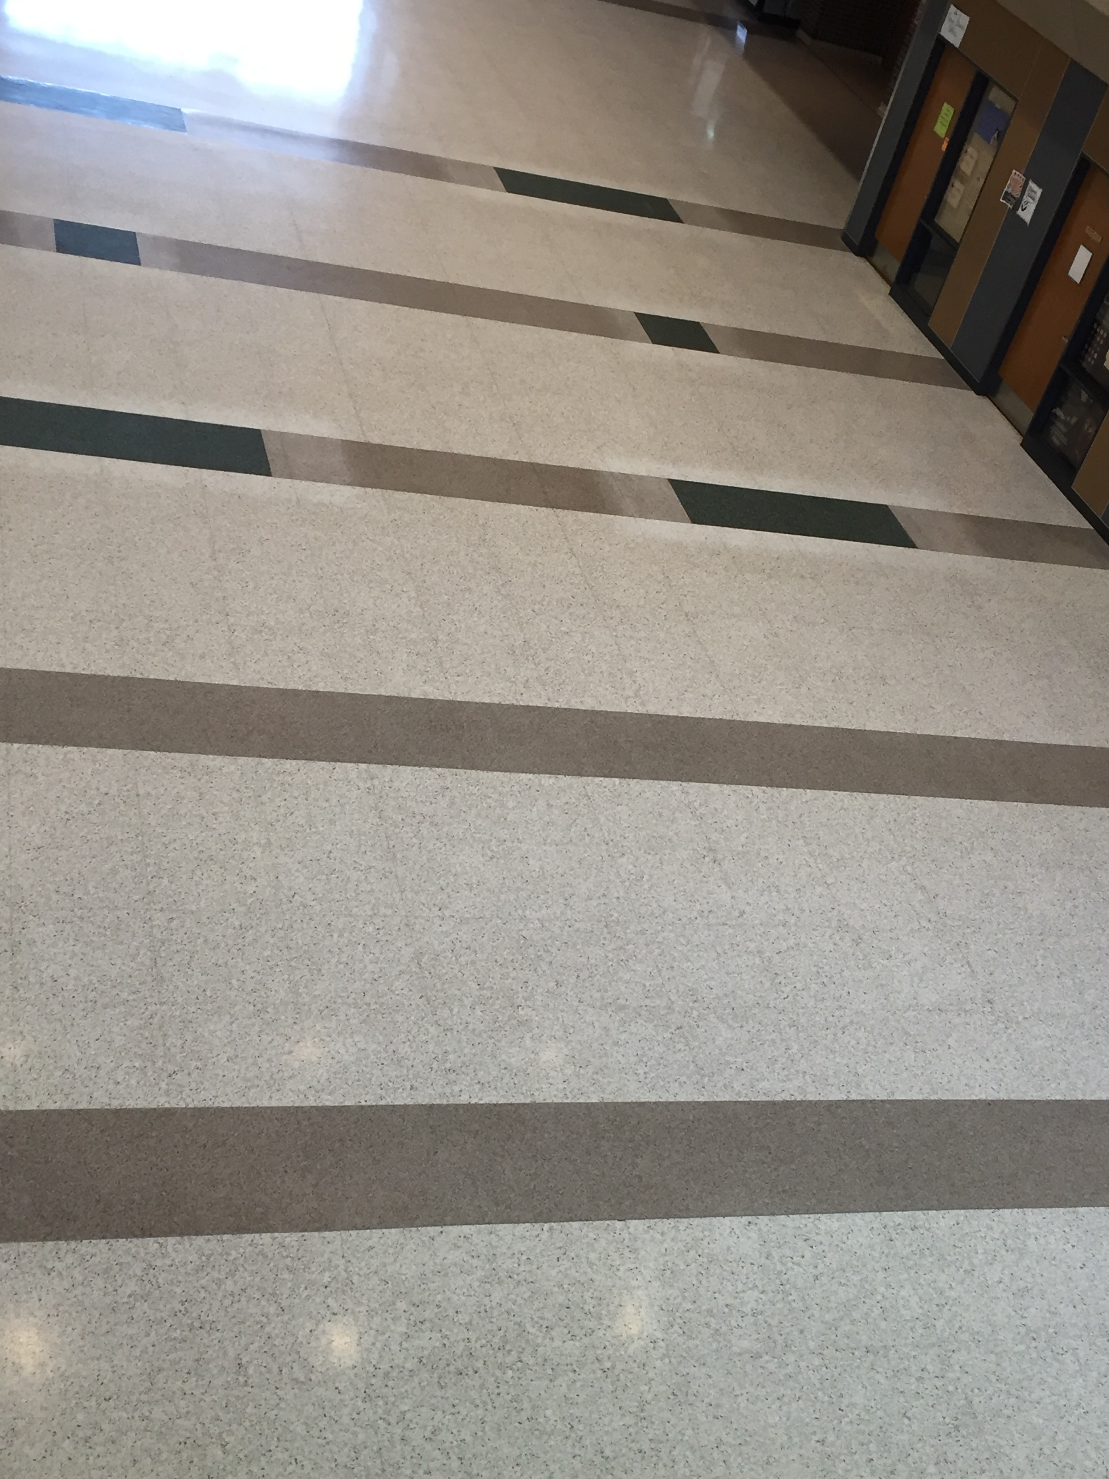
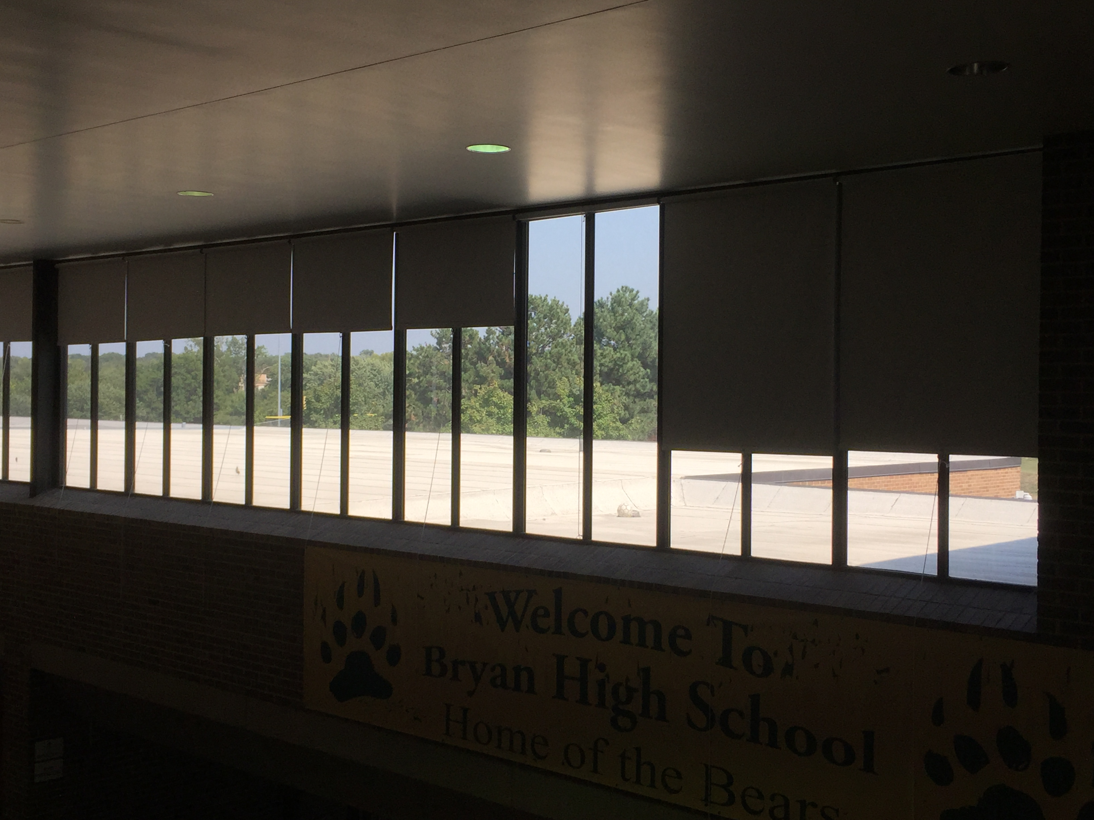
Where have you seen this pattern? (just pick 1 to code in Bricklayer-Lite)

Slide 16
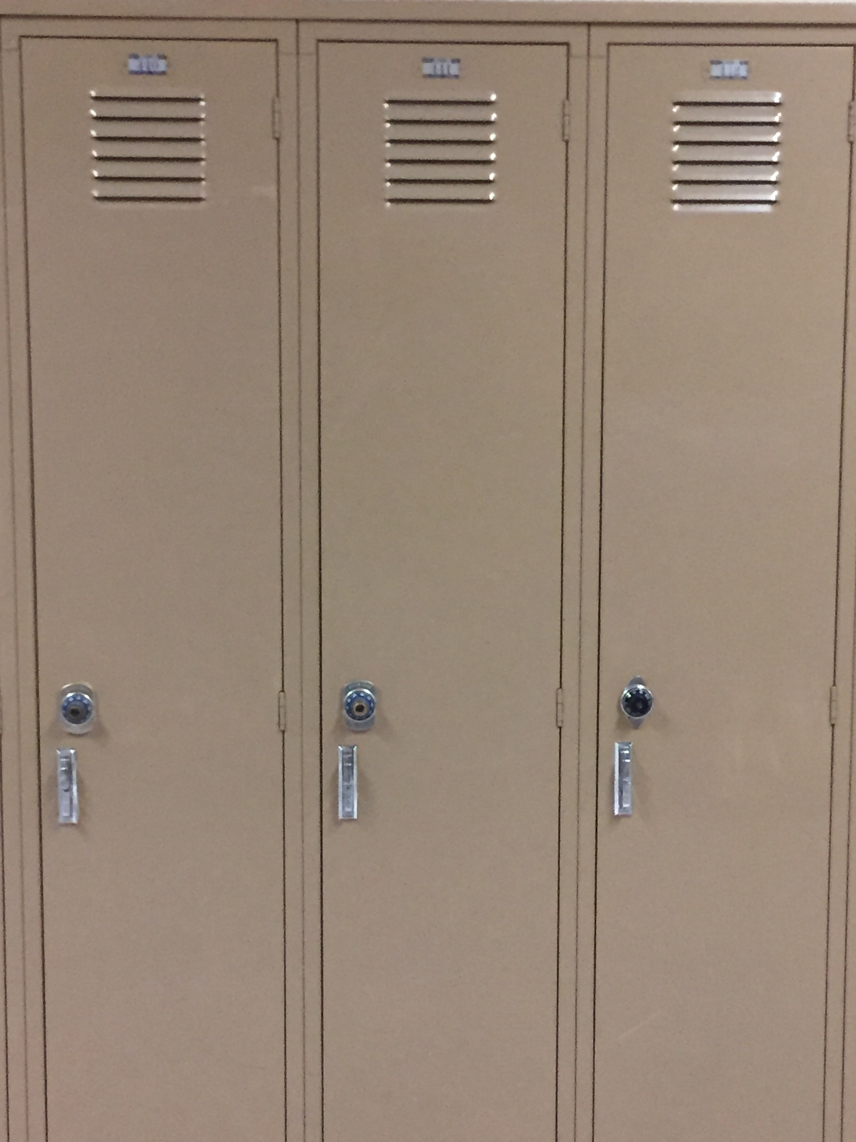
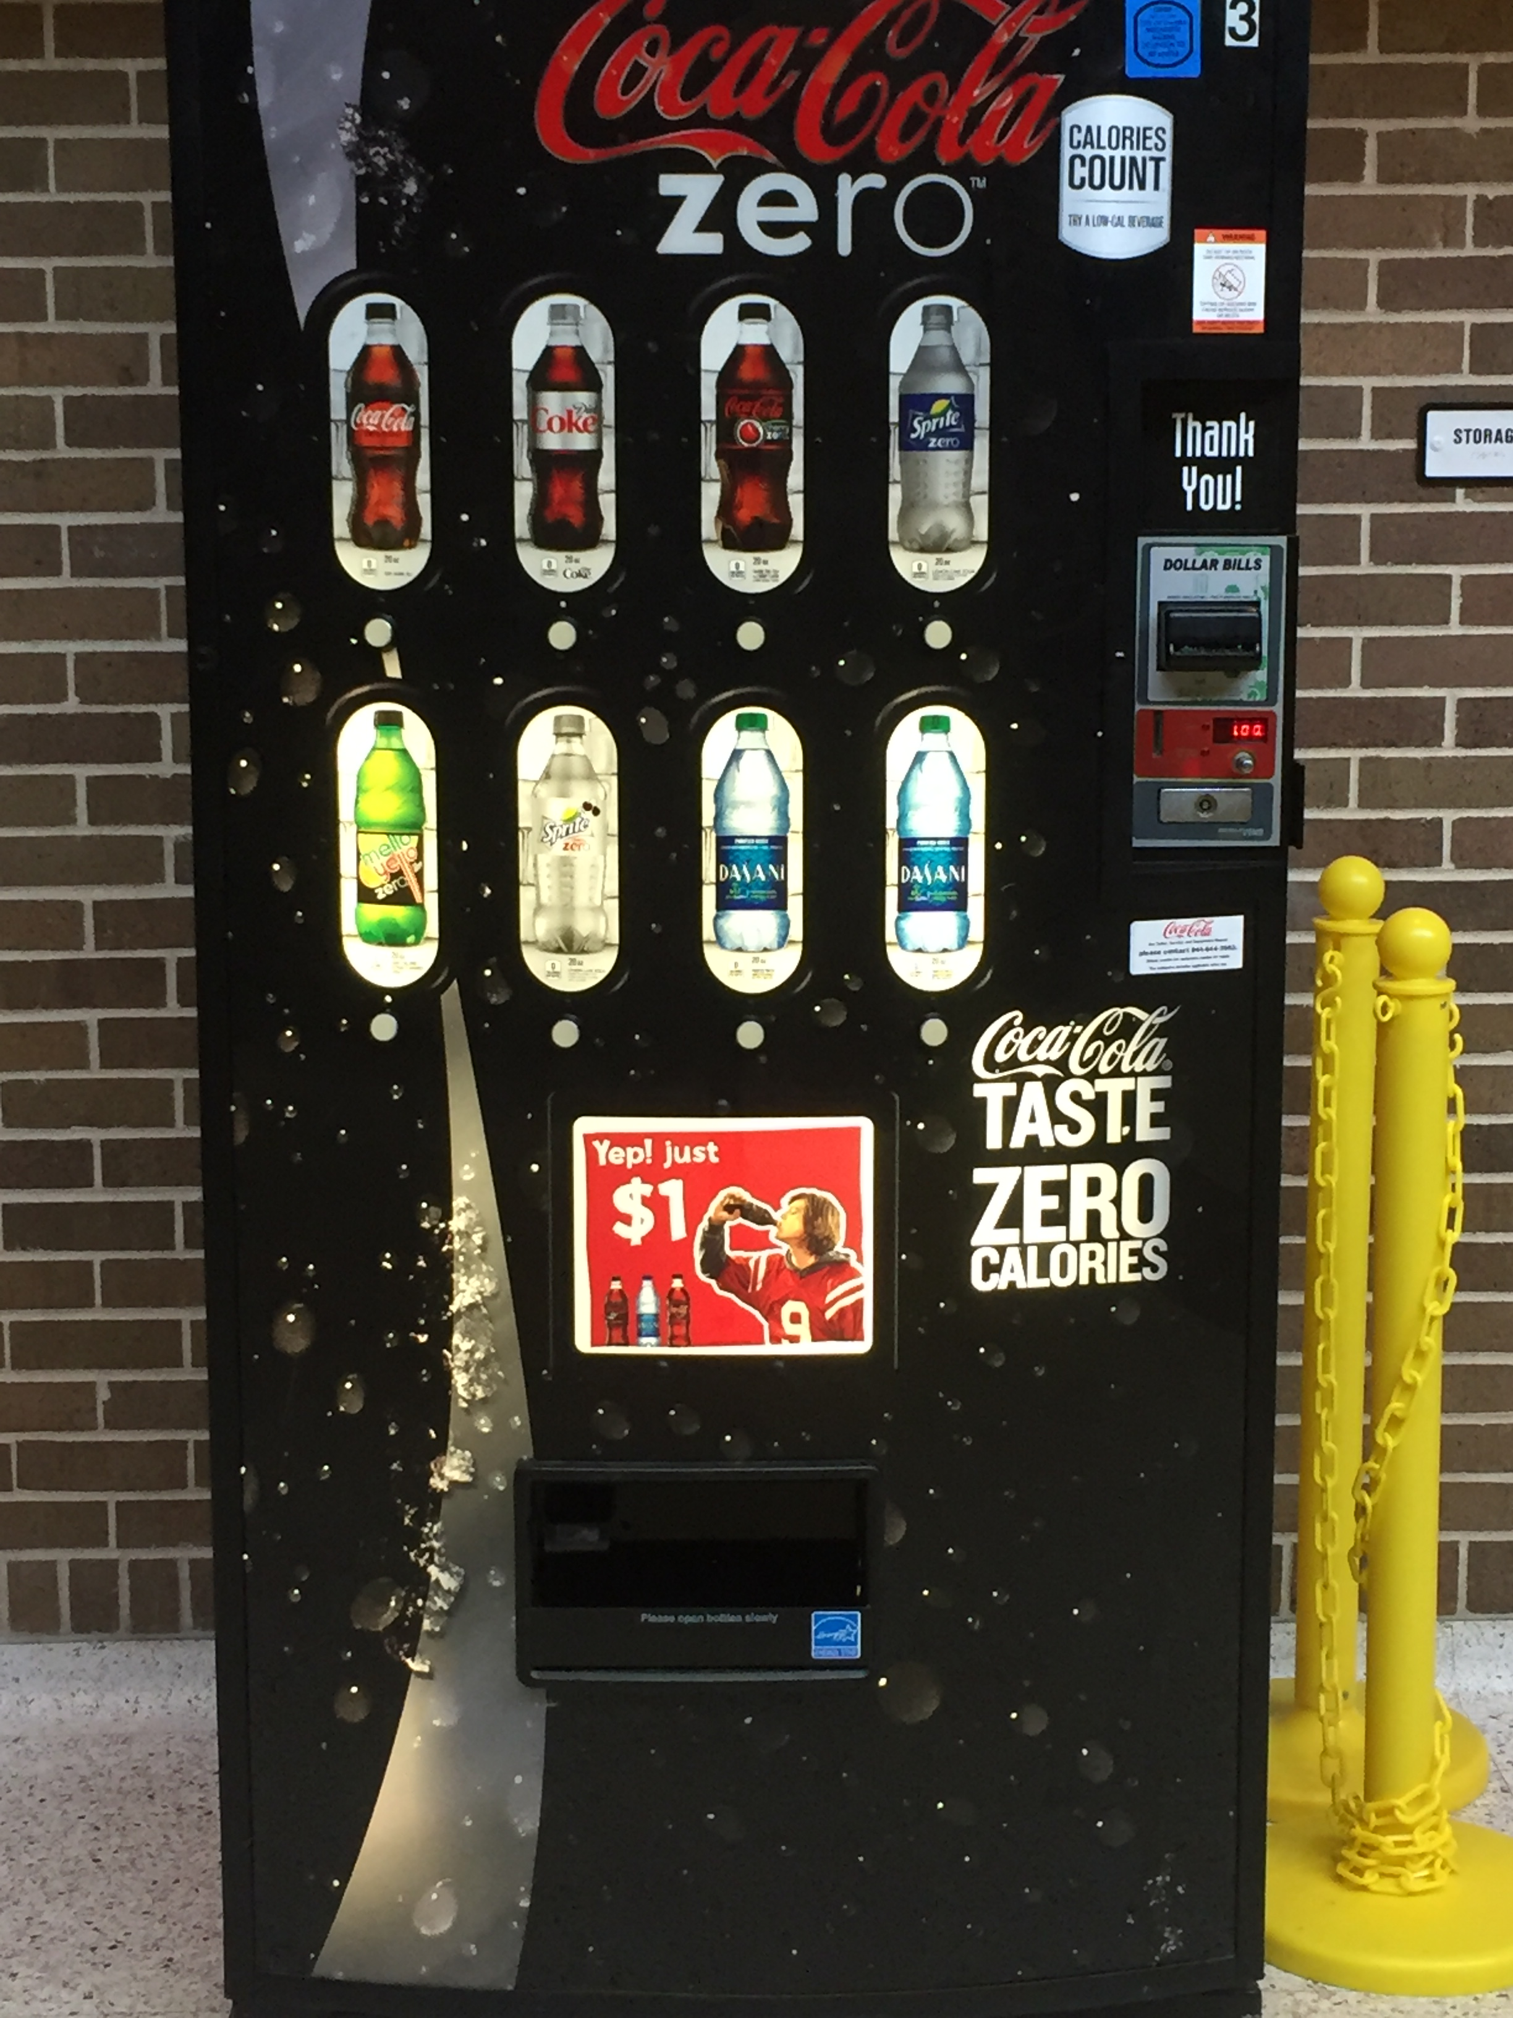
Challenge: Add enough detail to your code that someone would be able to identify either of the following images.

Slide 17
Exit Ticket
Explain the similarities and differences from The Grid and Bricklayer-Lite.
Talk about the process of transitioning from an image in our building, to recreating it in Pixel Art.

